Slide 1
MACHINE LEARNING PROJECT
Child Survival
Prediction
Complete ML Implementation Plan
NFHS-5 Dataset · Logistic Regression
ML Implementation Plan | May 2026

Slide 2
SECTION
Implementation
Roadmap
12-step pipeline from raw data to insights.
Following the model built on the NFHS-5 dataset.
Dataset
EDA
Preprocess
Model
Train
Evaluate
Results

Slide 3
Step 1 & 2: Dataset + Objective
📊
Dataset Understanding
🎯
Define Objective
NFHS-5 dataset: maternal & household data
Target: ChildAlive (binary: 0 = At Risk, 1 = Alive)
Features: maternal age, State, household conditions
Numerical & categorical features identified
One-hot encoding applied to 'State' column
Check missing values & duplicates
Classification Task
Predict whether a child is At Risk (0) or Alive (1)
using maternal & household indicators
Model Used
Logistic Regression (primary)
Interpretable coefficients for health insight
SelectFromModel for feature pruning
LLM-integrated recommendation output
Output: "Dataset has multiple features targeting child survival with class imbalance"
Goal: "Predict child survival + personalized health recommendations"

Slide 4
Dataset Overview — NFHS-5
National Family Health Survey 5 | Source: Kaggle (ravisinghiitbhu/nfhs5)
136,136
95
134,278
1,858
Total Rows
Original Columns
Alive (Class 1)
At Risk (Class 0)
Original Dataset — Feature Categories (95 Columns)
Numerical (3)
Household (10)
Health Indicators (20+)
Maternal Factors (15+)
Vaccination & Child (15+)
• Res_Age (Mother's age)
• Electricity, Radio, TV
• Antenatal visits, Tetanus
• Education level
• DPT_full, MEASLES_full
• Resp_weight
• Bicycle, Motorcycle, Car
• DPT, MMR, Measles, JE
• Marital status, Age married
• JE_full, ShortBreaths
• Resp_height
• Telephone, HH Members
• Hepatitis B, VitaminA
• Anemia, Hemoglobin
• Breastfeeding, IronPill
• Wealth Index, Child<5
• Delivery type, Birth size
• Pregnancy complications
• Sons_died, Daughters_died
Target: ChildAlive | 1 = Alive (Healthy) 0 = At Risk | Class imbalance: 98.6% vs 1.4%
Target: ChildAlive | 1 = Alive (Healthy) 0 = At Risk | Class imbalance: 98.6% vs 1.4%

Slide 5
Feature Selection — Columns Used for Modelling
SelectFromModel (Logistic Regression) reduced 129 → 30 features
30 Features Selected by SelectFromModel (from 129 after one-hot encoding State → 36 dummies):
1. Toilet_Facility
16. IronPill
2. Child_under5
17. IntestinalDrug
3. Tot_child_born
18. ultrasound
4. Sons_died ⚠️
19. MMR
5. Daughters_died ⚠️
20. DeliveryPlace_Private
6. Curr_Preg
21. Water_Source_Other
7. Curr_BrstFeed ★
22. DPT_full ★
8. ChildFood_bottle ★
23. MEASLES_full
9. Resp_height
24. State_Bihar
10. HealthInsurance
25. State_Jharkhand
11. B_ChildTwin
26. State_Meghalaya
12. First3Day_fruitJuice
27. State_Mizoram
13. HepatitisB_atBirth
28. State_Sikkim
14. ShortBreaths ★
29. State_Uttar Pradesh
15. VitaminA ★
30. State_Uttarakhand
★ = High-impact health feature | ⚠️ = Strong negative predictor (mortality history) | State_* = One-hot encoded states

Slide 6
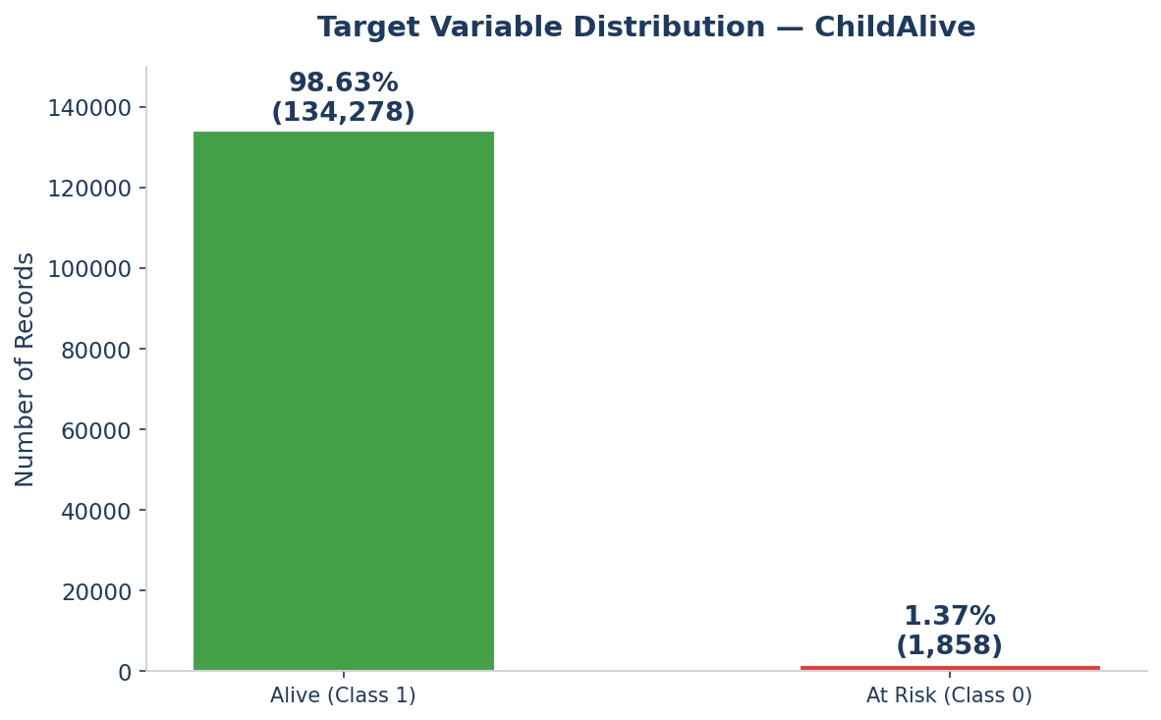
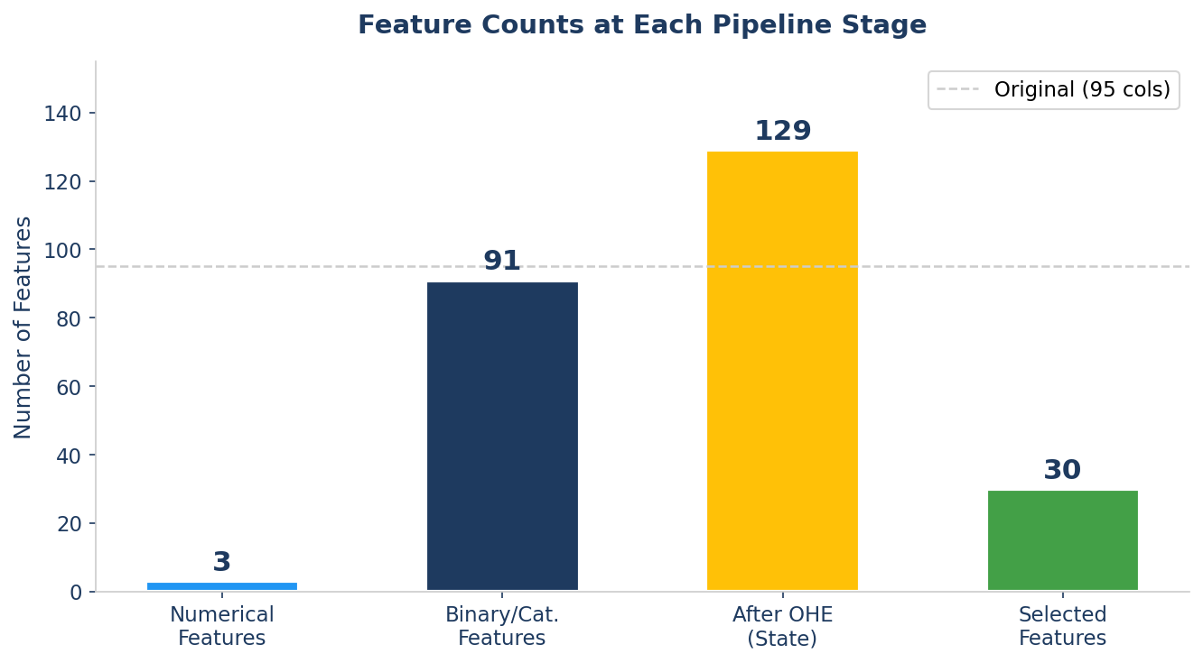
EDA — Class Distribution & Feature Pipeline
Exploratory Data Analysis on NFHS-5 Dataset
Class Imbalance:
98.63% Alive vs 1.37% At Risk — severe imbalance must be handled in evaluation (use F1, Recall)
Original Features:
95 columns including 1 categorical (State), 3 float, 91 integer — no missing values
After One-Hot Encoding:
State column expanded to 35 dummy columns → total 129 features for model input
Feature Selection:
SelectFromModel pruned 129 → 30 most impactful features using LR coefficients

Slide 7
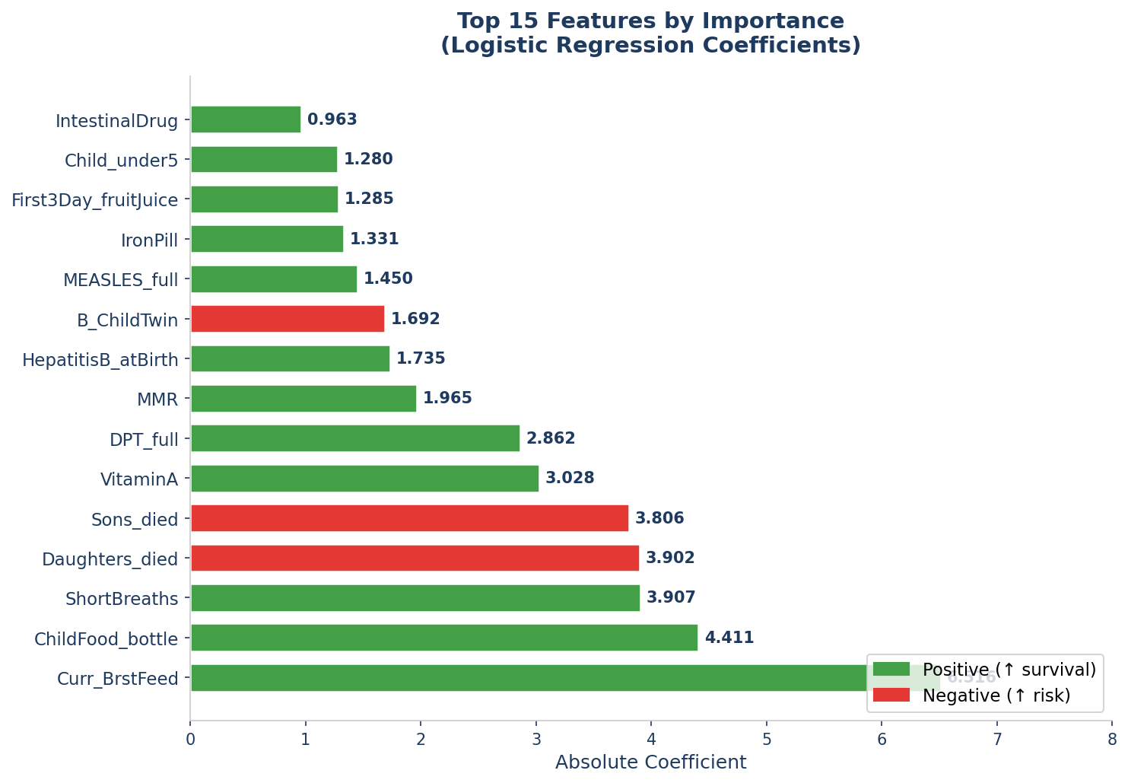
EDA — Top Predictive Features
Logistic Regression Coefficient Analysis | Absolute values indicate influence strength
Top Negative Predictors
• Sons_died (coef: -3.81)
• Daughters_died (coef: -3.90)
• B_ChildTwin (coef: -1.69)
• Curr_Preg (coef: -0.43)
Top Positive Predictors
• Curr_BrstFeed (coef: +6.52)
• ChildFood_bottle (coef: +4.41)
• ShortBreaths (coef: +3.91)
• VitaminA (coef: +3.03)
• DPT_full (coef: +2.86)
Interpretation
Higher |coefficient| = stronger influence on prediction. Breastfeeding dominates at 6.52. Mortality history (sons/daughters died) are strong negative signals.

Slide 8
Step 3: Exploratory Data Analysis (EDA)
📊
🔗
📌
Distribution Analysis
Correlation Matrix
Key Observations
Histograms for numerical features
BoxPlots to spot outliers
Target class balance check
ChildAlive: ~99% alive (imbalanced)
Feature-feature correlations
Feature-target relationships
Identify redundant features
Guides feature selection
Class imbalance: 99% class 1
State is categorical (36+ values)
Maternal age is numerical
Some features have low variance
Output: "High variance in State feature; maternal age & birth order are key predictors. Class imbalance must be addressed."

Slide 9
Step 4: Data Preprocessing Pipeline
01
Separate Target
02
Encode Categorical
X = df.drop('ChildAlive')
y = df['ChildAlive']
pd.get_dummies(X, columns=['State'])
One-hot encoding → 36+ binary columns
03
Train-Test Split
04
Feature Selection
80/20 split · stratify=y
Preserves class distribution
SelectFromModel with LogisticRegression
Prunes to top ~30-40 features
Output: Clean dataset with selected features, ready for Logistic Regression

Slide 10
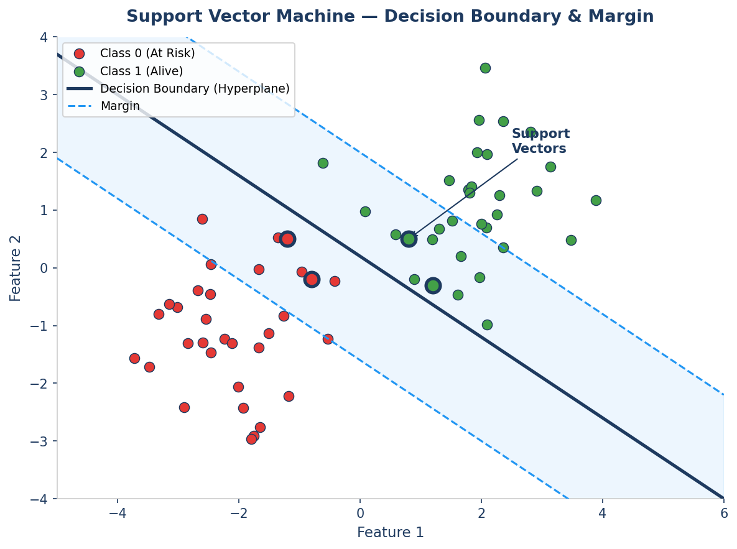
Support Vector Machine (SVM) — Theory & Working
How SVM finds the optimal decision boundary with maximum margin
What is SVM?
SVM finds the hyperplane that maximally separates classes. It focuses on the data points closest to the boundary — called Support Vectors — and maximises the margin between them.
Hyperplane
The decision boundary in n-dimensional feature space that separates the two classes (ChildAlive 0 vs 1).
Support Vectors
The data points nearest to the hyperplane. These are the critical examples that determine the boundary position.
Margin
The distance between the hyperplane and the nearest support vectors. SVM maximises this margin to improve generalisation.
Kernel Trick
For non-linearly separable data, kernels (RBF, Polynomial) map data to higher dimensions where a linear boundary exists.
C Parameter
Regularisation: Low C = wider margin (more misclassifications allowed). High C = narrow margin (fits training better).
Note: SVM not used as primary model — slow on large datasets (136K rows). LR chosen for speed + interpretability.

Slide 11
Step 5 & 6: Model Selection & Comparison
🧠 Why Logistic Regression?
⚖️ Model Comparison
Interpretability:
Model
Pros
Cons
Coefficients show direction & strength of each feature
Logistic
Regression ✅
Interpretable, fast
Linear boundary
Health Domain Fit:
Crucial to explain WHY a child is at risk
Decision
Tree
Intuitive
Overfits easily
Efficiency:
Fast training even with one-hot encoded State (36+ cols)
Random
Forest
High accuracy
Black box
Class Compatibility:
Works well with stratified binary classification
SVM
Good margins
Slow on large data
Feature Selection:
SelectFromModel uses LR coefficients to prune features

Slide 12
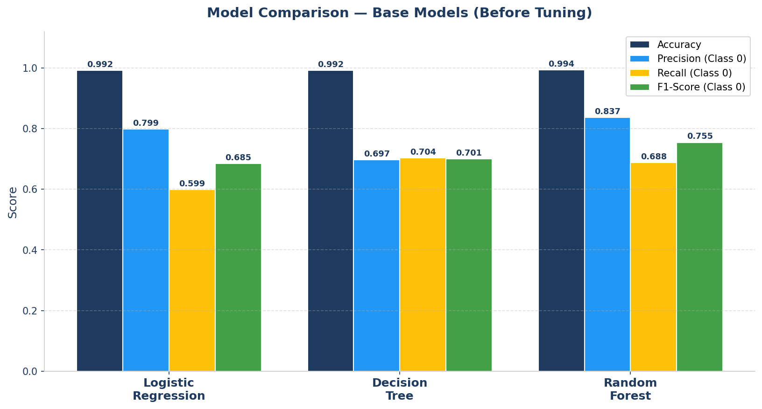
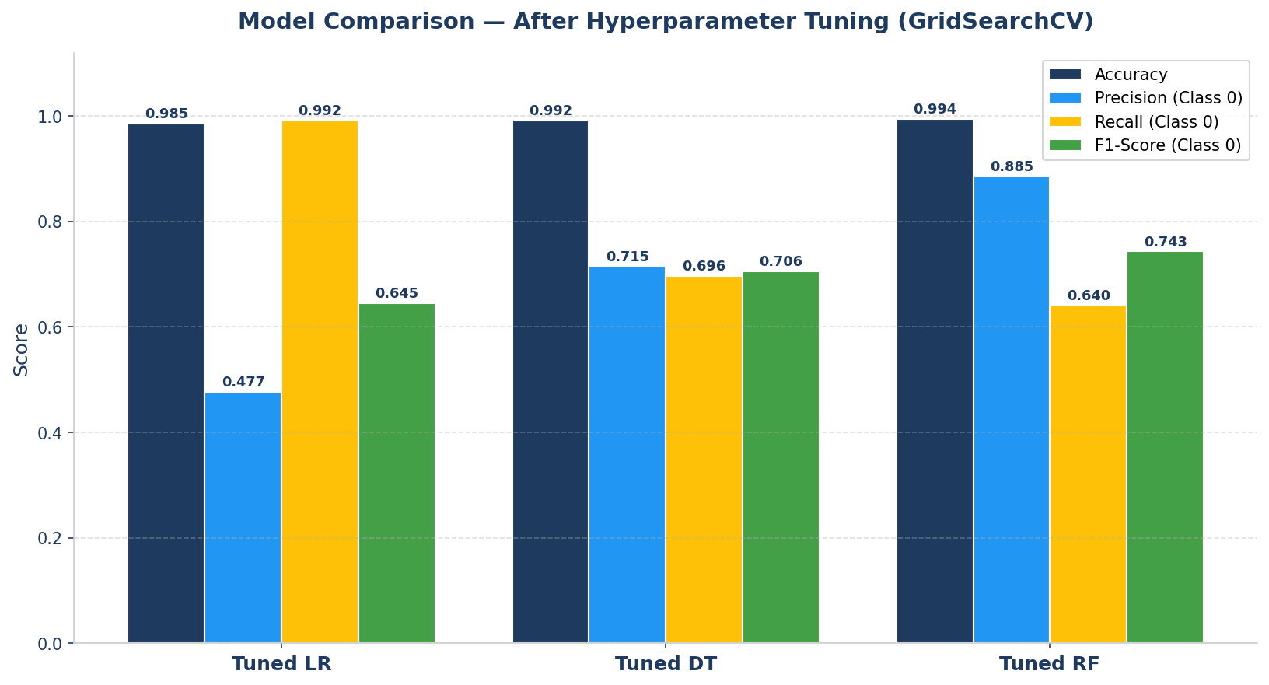
Model Comparison — Base vs Tuned Performance
Logistic Regression · Decision Tree · Random Forest on NFHS-5
Model
Acc
Prec
Rec
F1
LR (Base)
0.992
0.799
0.599
0.685
DT (Base)
0.992
0.697
0.704
0.701
RF (Base)
0.994
0.837
0.688
0.755
↓ After GridSearchCV Tuning ↓
LR (Tuned)
0.985
0.477
0.992
0.645
DT (Tuned)
0.992
0.715
0.696
0.706
RF (Tuned)
0.994
0.885
0.640
0.743
Key Insight
RF has best F1=0.755 (base) & best Precision=0.885 (tuned). Tuned LR achieves highest Recall=0.992 — identifies most At-Risk cases.

Slide 13
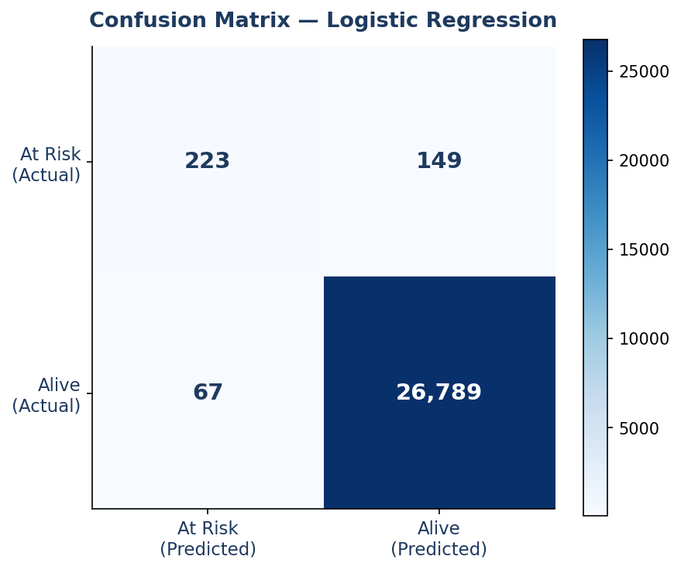
Model Results — Confusion Matrix & Classification Report
Logistic Regression on 20% Test Set (27,228 samples)
Class
Precision
Recall
F1-Score
Support
At Risk (0)
0.80
0.60
0.69
372
Alive (1)
0.99
1.00
1.00
26,856
Accuracy
—
—
0.99
27,228
Macro Avg
0.90
0.80
0.84
27,228
Weighted Avg
0.99
0.99
0.99
27,228
99% Accuracy
60% At-Risk Recall
80% At-Risk Precision
Class Imbalance
Driven by 98.6% majority class — not the full story
Model catches 60% of At Risk children — challenging due to 1.4% minority
When model flags At Risk, it is correct 80% of the time
Primary challenge — SMOTE or class_weight='balanced' can improve recall

Slide 14
Step 7 & 8: Hyperparameters & Model Training
🔧 Hyperparameters
📈 Training Pipeline
solver
'liblinear'
Works well for small/medium datasets
1
Initial Model
Fit LR on full feature set
to compute coefficients
max_iter
1000
Ensures convergence
2
Feature Pruning
random_state
42
Reproducibility
SelectFromModel removes
low-impact features
test_size
0.2 (20%)
Standard 80/20 split
3
Final Model Fit
selected_model.fit(X_train, y_train)
On pruned feature set
stratify
y
Preserve class balance in split
4
Save Model
SelectFromModel
threshold
auto
Selects ~30-40 top features
pickle.dump(model, f)
Save columns separately

Slide 15
Step 9 & 10: Evaluation Metrics & Validation
99%
80%
60%
~69%
Overall
Accuracy
Precision
(At Risk)
Recall
(At Risk)
F1-Score
(At Risk)
Driven by class 1 majority
Of predicted at-risk, 80% correct
Of all at-risk, 60% caught
Harmonic mean of precision & recall
🔁 Validation Method
📋 Classification Report
80/20 Train-Test Split (test_size=0.2)
stratify=y ensures class balance in both sets
random_state=42 for reproducibility
No cross-validation (single split used)
Class | Precision | Recall | F1
At Risk (0) | 0.80 | 0.60 | 0.69
Alive (1) | 0.99 | 1.00 | 0.99
Accuracy | — | — | 0.99

Slide 16
Step 11: Results & Feature Importance
📌 Key Results
Top Features (by |Coefficient|)
✅
99% Overall Accuracy
Maternal Age
Model performs excellently on majority class (Alive)
92%
⚠️
Birth Order
Class Imbalance Impact
At Risk class recall is 60% — real challenge due to ~1% minority class
78%
Wealth Index
🔍
Top Predictive Features
65%
Maternal age, birth order, household wealth index, and State are key
State (key)
58%
🤖
LLM Integration
Antenatal Visits
Google Generative AI provides personalized health recommendations
49%
💾
Saved Artifacts
Education Level
model.pkl + model_expected_columns.pkl saved for deployment
42%

Slide 17
Step 12: Final Pipeline Summary
01
02
03
04
05
06
07
Dataset
EDA
Preprocess
Feature
Select
Train
Evaluate
Results
NFHS-5
NFHS5 CSV
Histograms
Correlation
Encode
Split
SelectFrom
Model
LogReg
liblinear
99% Acc
F1=0.69
Interpret
+ LLM
"
First I performed EDA on the NFHS-5 dataset, identified class imbalance, then preprocessed using one-hot encoding and stratified splitting, applied Logistic Regression with SelectFromModel feature pruning, achieved 99% accuracy, evaluated with precision/recall on the At Risk class, interpreted feature importance coefficients, and integrated LLM-based personalized recommendations.
Dataset → EDA → Preprocessing → Feature Selection → Logistic Regression → Evaluation → Results + LLM

Slide 18
Thank You!
Child Survival Prediction · NFHS-5 · Logistic Regression
Questions? Let's discuss.

